Slide 1
Physical Chemistry
Ying Hu
(Fifth edition)
Bilingual Program
版权所有：华东理工大学物理化学教研室

Slide 2
Part V Extension
Chapter 16
Electrolyte Solutions
Bilingual Program
版权所有：华东理工大学物理化学教研室

Slide 3
Framework of the Chapter
Electrolyte solutions
Equilibrium Properties
Transport Properties
Reaction-Rate Properties
Mechanism of
Electric
Conductance
Ionic Reactions
in Solution
Diversity of
Activities
Debye-Hückel
Theory
Semi-Empirical
Methods
Electric
Conductivity
Diffusion
Coefficients
Applications
Theoretical
Semi-Empirical
Methods

Slide 4
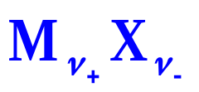
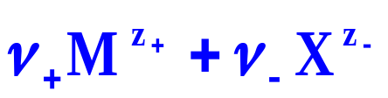
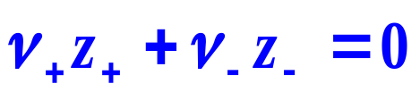
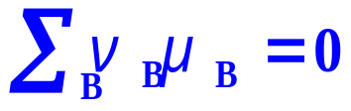
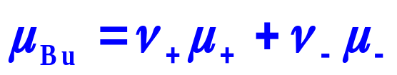
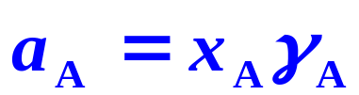
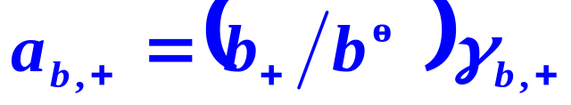
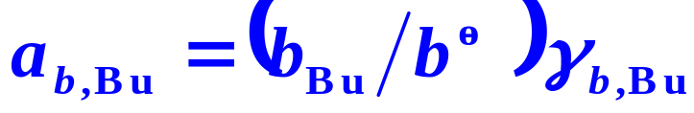
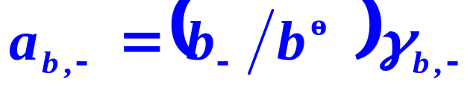
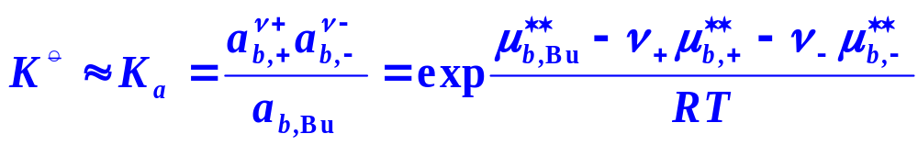
16.2 Activities of Electrolyte Solutions
1. Activities of Various Components
undissociated electrolyte

Slide 5


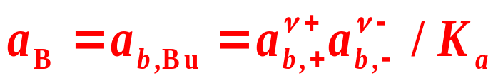
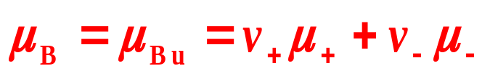
16.2 Activities of Electrolyte Solutions
Activity a_{B} of Electrolyte as a Whole
The reference state of a_{B}
The activity a_{B} is the same as that of the undissociated electrolyte a_{b,Bu}
The chemical potential μ_{B} of the electrolyte as a whole equals that of the undissociated electrolyte μ _{Bu}

Slide 6
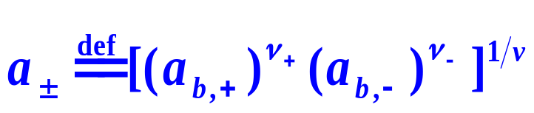
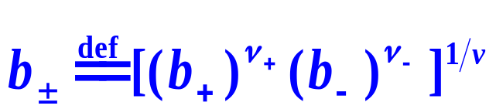
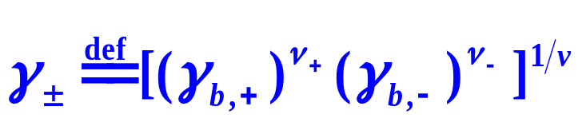
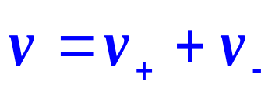

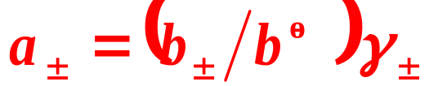

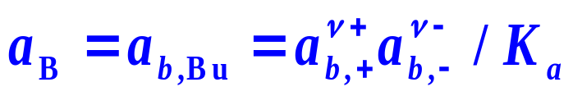
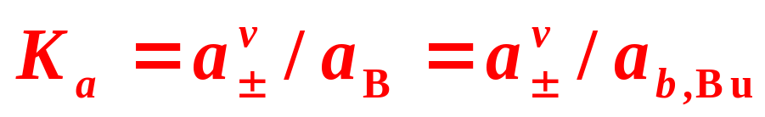
16.2 Activities of Electrolyte Solutions
3. Mean Ionic Activity
In electrolyte solutions, cations and anions always exist simultaneously, it is difficult to determine the activity of a single kind of ions.
Mean ionic activity
Mean ionic molarity
Mean ionic activity factor

Slide 7
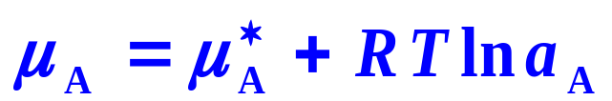
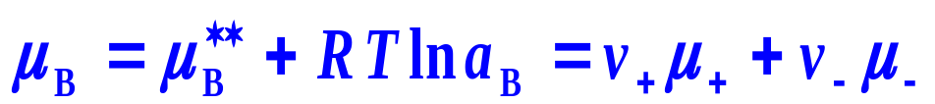

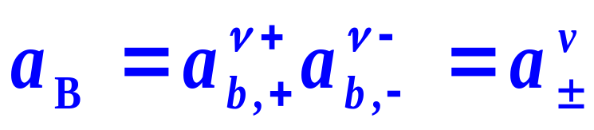
16.2 Activities of Electrolyte Solutions
4. Special Common Practice for First-Kind Electrolyte Solutions
Activities of Solvent and Ions
Activity of Electrolyte as a Whole
First-Kind Electrolyte

Slide 8
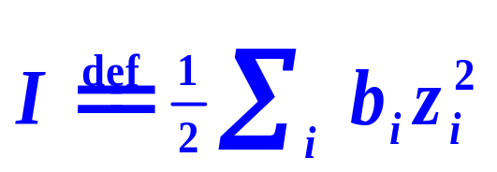
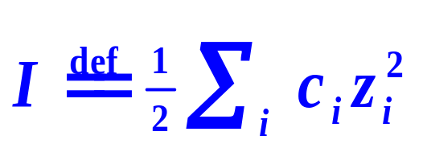
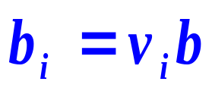
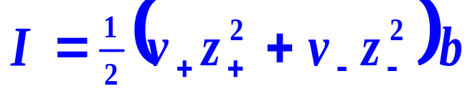
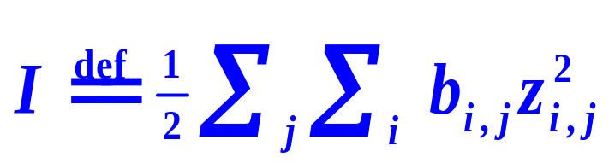
16.2 Activities of Electrolyte Solutions
Ionic Strength
or
For a single first-kind electrolyte solution
For a mixture of first-kind electrolyte solution

Slide 9
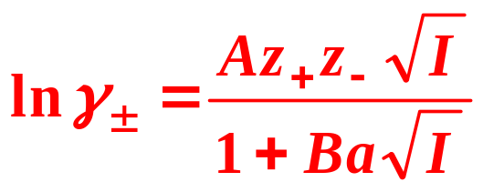
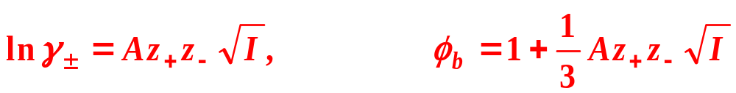
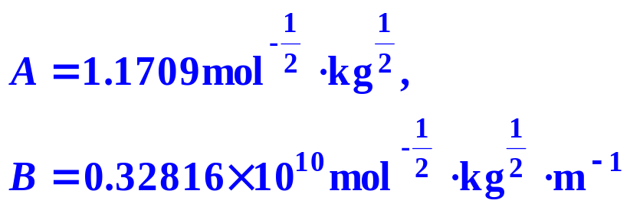
16.3 Theories and Semi-Empirical Methods
Debye-Hückel Equation of Activity Factor
Debye-Hückel limiting law
If the solution is very dilute
If the solvent is water, at 25°C,

Slide 10
16. Electrolyte Solutions
    I. Equilibrium Properties of Electrolyte
    16.2 Activities of Electrolyte Solutions
    16.3 Theories and Semi-Empirical Methods
    16.4 Applications

Slide 11
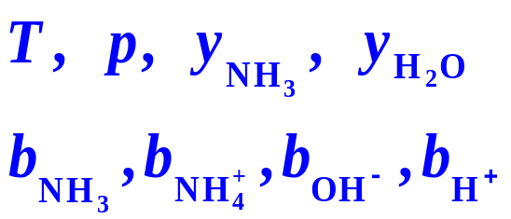
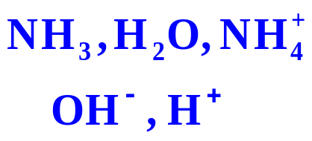

16.4 Applications
Example
The absorption of ammonia in gas phase by water
8 variables
NH₃、H₂O、Air
How many independent variables are there? How can those dependent variables be calculated?

Slide 12




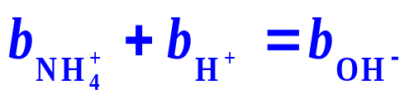
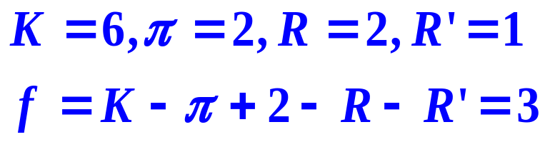
16.4 Applications
Chemical Equilibria
NH₃、H₂O、Air
Electro Neutrality
Number of Independent Variables

Slide 13




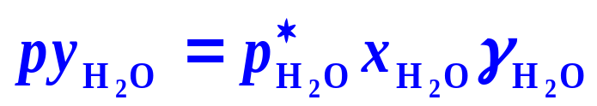
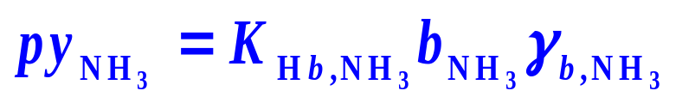
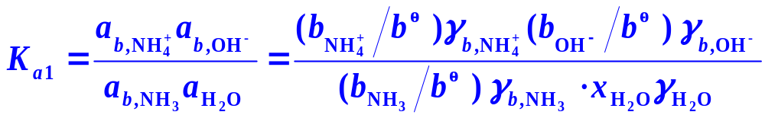
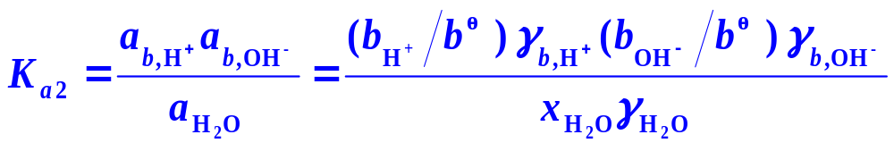
16.4 Applications
Phase Equilibria
Chemical Equilibria
Electro Neutrality

Slide 14
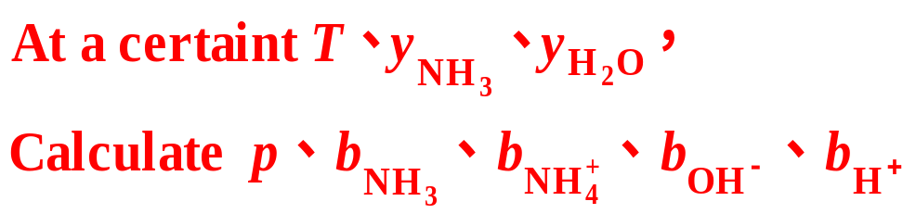
16.4 Applications
NH₃、H₂O、Air
Three freedom degrees,
Five equations provided,
Five variables can be solved!

Slide 15
II. Transport Properties of Electrolyte Solutions
Bilingual Program
版权所有：华东理工大学物理化学教研室

Slide 16
16. Electrolyte Solutions
II. Transport Properties of Electrolyte Solutions
    16.5 Mechanism of Electric Conductance of Electrolyte Solutions
    16.6 Mobility and Transference Number of Ions
    16.7 Electric Conductivity
    16.8 Other Applications of Electric Conductance
    16.9 Diffusion in Electrolyte Solutions
    16.10 Theoretical and Semi-Empirical Methods

Slide 17
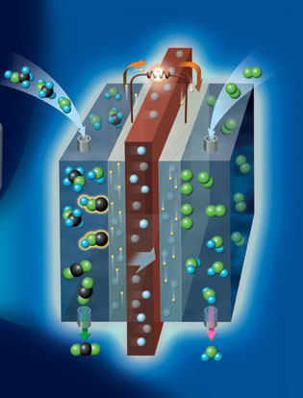
16.5 Mechanism of Electric Conductance of Electrolyte Solutions
Two Categories of Conductors
The first-kind conductor
Metals rely on the free electrons to conduct the electricity.
The second-kind conductor
Electrolyte solutions rely on the ionic migration and the electrode reactions to conduct the electricity

Slide 18
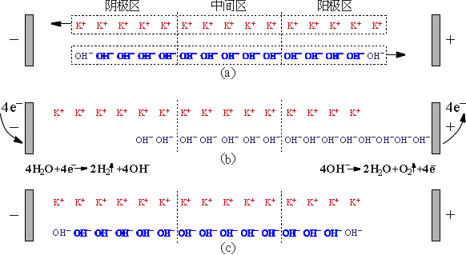
16.5 Mechanism of Electric Conductance of Electrolyte Solutions
Example
The electrolysis of water
( the electrolyte such as KOH is used to enhance the conductance )
Cathode
compartments
Intermediate
compartments
Anode
compartments
2H₂O→2H₂+O₂ ， 4KOH(anode region)→ 4KOH(cathode region)

Slide 19
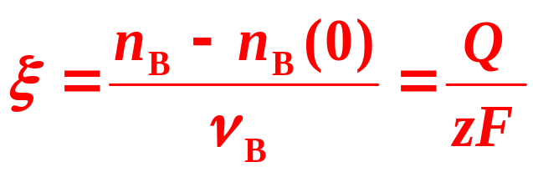
16.5 Mechanism of Electric Conductance of Electrolyte Solutions
Faraday’s Law
When a current is passing through an electrolyte solution, the reaction extent ξ of the electrode reaction is proportional to the amount of electricity Q passed and inversely proportional to the reaction charge number z
z — the absolute value of the change of number of electrons in an electrode reaction
F is the Faraday constant F = 96485C∙mol⁻¹

Slide 20
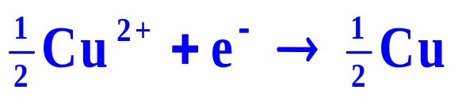

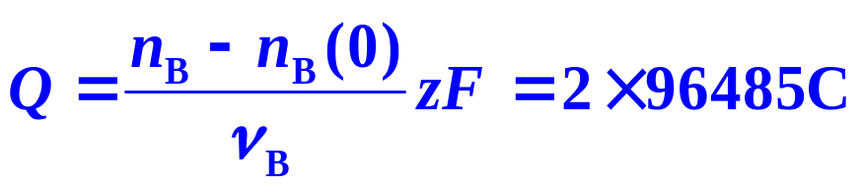
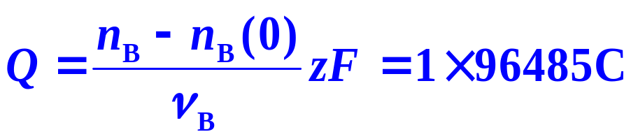
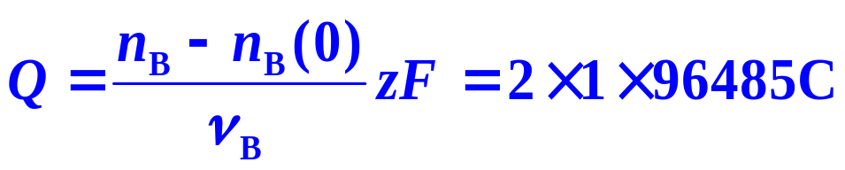
16.5 Mechanism of Electric Conductance of Electrolyte Solutions
Example
If Cu is taken as B, ν_{B}=1/2
1mol Cu →
If Cu/2 is taken as B ν_{B}=1
1mol Cu/2 →
2mol Cu/2 →

Slide 21
16. Electrolyte Solutions
II. Transport Properties of Electrolyte Solutions
    16.5 Mechanism of Electric Conductance of Electrolyte Solutions
    16.6 Mobility and Transference Number of Ions
    16.7 Electric Conductivity
    16.8 Other Applications of Electric Conductance
    16.9 Diffusion in Electrolyte Solutions
    16.10 Theoretical and Semi-Empirical Methods

Slide 22
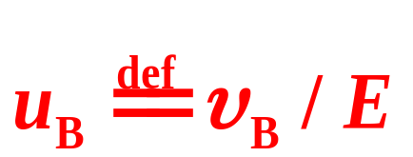
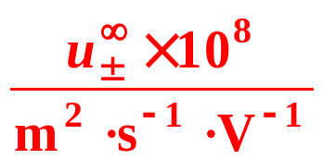
16.6 Mobility and Transference Number of Ions
1. Mobility of Ions
Definition
The ionic migration speed in unit electric field intensity
Mobility at Infinite Dilution
in water at 298K,
H+ | Na+ | K+ | Zn+ | OH⁻ | Cl ⁻ | Br ⁻ | SO₄ ²⁻
36.23 | 5.19 | 7.62 | 5.47 | 20.64 | 7.91 | 8.09 | 8.29

Slide 23
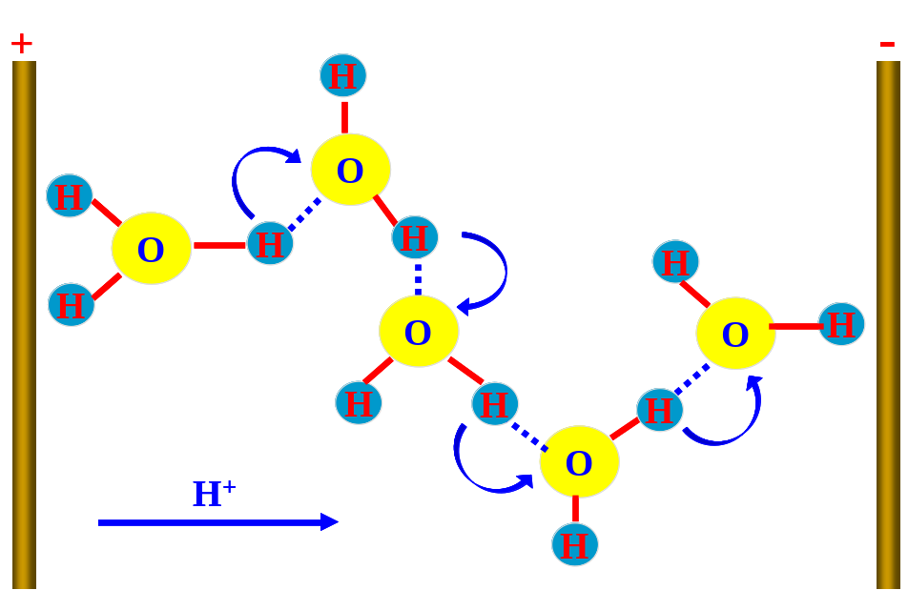
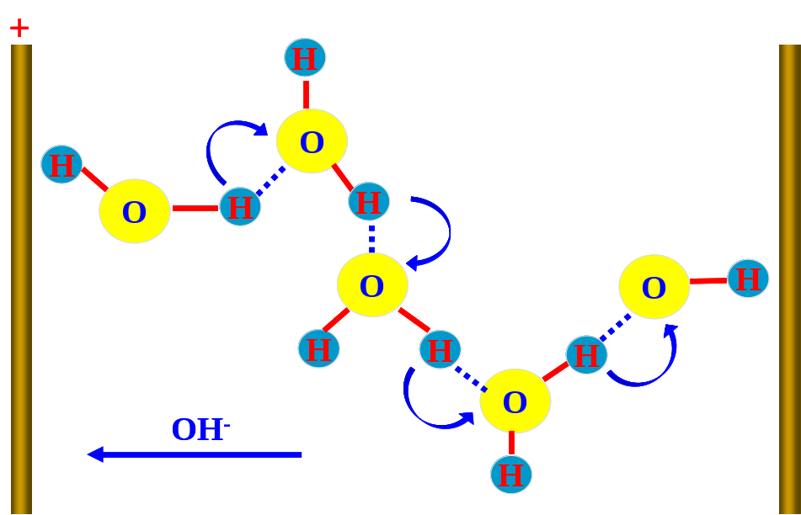

16.6 Mobility and Transference Number of Ions
Conductance mechanisms of H₃O⁺ and OH⁻
Affecting Factors
The higher the concentration, the stronger the interaction among ions, the smaller the mobility.
The higher the temperature, the lower the viscosity leading to the smaller resistance to the migration, the larger mobility

Slide 24





16.5 Mechanism of Electric Conductance of Electrolyte Solutions
2. Transference Number
Definition
Definition
The ratio of the current transmitted by a certain ions to the total current
Relation between Transference Number and Mobility
For a symmetrical electrolyte in which the charge numbers z± and hence the ν± are the same for both ions, then

Slide 25

16.5 Mechanism of Electric Conductance of Electrolyte Solutions
Experimental Determination of Transference Number
(1) Hittorf Method
Coulomb meter
Cathode
Anode

Slide 26

16.5 Mechanism of Electric Conductance of Electrolyte Solutions
Example
A silver nitrate solution is electrolyzed using the silver electrodes. The initial concentration is b = 0.04356mol⋅kg⁻¹, the electrode reactions are:
Anode:
Cathode:
Analysis the whole solution in the anode compartment after electrolysis, the result is: it contains 1.391×10⁻³mol of AgNO₃ and 23.14g of H₂O. The silver deposited in the Coulomb meter is 0.723×10⁻³mol. Calculate the transference numbers of Ag⁺ and NO₃–.

Slide 27





16.5 Mechanism of Electric Conductance of Electrolyte Solutions
Solution:
Material balance for Ag⁺ ions in the anode compartment.
Suppose that the amount of water keeps unchanged
Because the anode reaction creates Ag⁺,
Δn_{electrode reaction}=+0.723×10⁻³mol,
Then
Therefore,

Slide 28


16.5 Mechanism of Electric Conductance of Electrolyte Solutions
(2) material balance for NO₃⁻ ions in the anode compartment.
For NO₃⁻, Δn_{electrode reaction}= 0
Due to the electro neutrality, n_{before electrolysis} and n _{after electrolysis} for NO₃⁻ are the same as those for Ag⁺
Therefore,
The results are the same as those in (1).

Slide 29

16.5 Mechanism of Electric Conductance of Electrolyte Solutions
Experimental Determination of Transference Number
(2) Moving boundary method
_
Motion of a boundary between two ionic solutions having a common ion is observed as a current flows
l,Δt
+
M⁺X⁻ (leading)
mobility
N⁺X⁻(indicator)
denser

Slide 30
16.5 Mechanism of Electric Conductance of Electrolyte Solutions
(2) Moving boundary method
Example
_
CdCl₂ solution was first added into a vertical tube with the section area of 1.0×10⁻⁵ m², then HCl solution was carefully filled in above the CdCl₂ with a clear liquid-liquid interface maintained. After passing the electricity of 0.01 A for 200 s, the interface has moved up 0.17 m. the concentration of HCl solution is 10.0 molm⁻³. calculate the transference number of H⁺.
l,Δt
+

Slide 31



16.5 Mechanism of Electric Conductance of Electrolyte Solutions
(2) Moving boundary method
Solution
H⁺ ions carry an electricity of
The total amount of electricity passed is It.
The transference numbers of H⁺

Slide 32
16. Electrolyte Solutions
II. Transport Properties of Electrolyte Solutions
    16.5 Mechanism of Electric Conductance of Electrolyte Solutions
    16.6 Mobility and Transference Number of Ions
    16.7 Electric Conductivity
    16.8 Other Applications of Electric Conductance
    16.9 Diffusion in Electrolyte Solutions
    16.10 Theoretical and Semi-Empirical Methods

Slide 33


16.7 Electric Conductivity
1. Electric Conductivity
The conductance, G, of a solution is the inverse of its resistance R
As resistance is expressed in ohm, Ω, the conductance of a sample is expressed in Ω⁻¹. It is now the Siemens, S. 1 S = 1 Ω⁻¹. The conductance of a sample decreases with its length l and increases with its cross-sectional area A, that is
where κ is the conductivity.

Slide 34


16.7 Electric Conductivity
1. Electric Conductivity
Definition
The electric conductivity κ of electrolyte solutions is defined as the reciprocal of the electric resistivity ρ
The conductivity κ, can also be defined as the current density in unit electric field intensity.
The SI units of κ are Siemens per metre (S m⁻¹)

Slide 35

16.7 Electric Conductivity
Features of Electric Conductance of Electrolyte Solutions
(1) The electric conductivities of the strong acids and bases are among the largest, followed are those of the salts. Those of the weak electrolytes such as acetic acid (HAc) are the smallest due to their incomplete dissociation in solution.
(2) κ first increases with increasing c, after the maximum, it decreases.
Increasing concentration, the number of ions in unit volume also rises favoring the conductance, on the other hand, the interactions among ions strengthen weakening the conductance.

Slide 36




16.7 Electric Conductivity
2. Molar Electric Conductivity
Definition
Suppose a solution of concentration c with an amount of the electrolyte of n is placed in a conductance cell
V = c⁻¹×n
A = c⁻¹×n/l
G =κ A_{s} / l=κ c⁻¹n / l²=Λ_{m} n / l²，
Conductance cell
Λ_{m}= (G/n) l²
Molar conductance
Specify Elementary Entity

Slide 37


16.7 Electric Conductivity
Conductance G
Conductivity
Molar Conductivity
The conductance of a solution in unit electrode area and unit distance between electrodes.
The conductance of a unit concentration solution in unit distance between electrodes.

Slide 38

16.7 Electric Conductivity
Features of Molar Electric Conductance
Regardless of strong or weak electrolytes, Λ_{m} diminishes monotonically with increasing c.
For the strong electrolytes, the phenomenon attributes solely to the enhancement of ionic interactions with increasing c.
For the weak electrolytes, it is mainly because of the lowering of the degree of dissociation.
Variations of molar electric conductivity at 25 ℃ with square root of concentration

Slide 39






16.7 Electric Conductivity
Kohlrausch Relation
For the dilute solution of strong electrolytes
the molar electric conductivity at infinite dilution, is Λ_{m} when the concentration approaches zero.
Relation between Molar Electric Conductivity and Mobility

Slide 40








16.7 Electric Conductivity
Relation between Molar Electric Conductivity and Mobility
Calculate Mobilities by Molar Electric Conductivity and Transference Numbers
Calculate Dissociation Constant by Molar Electric Conductivity

